Slide 1
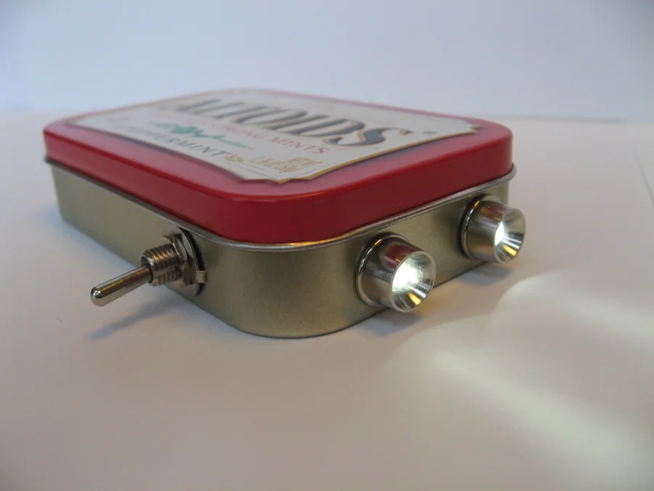
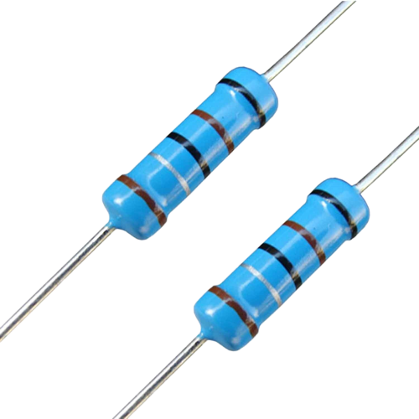
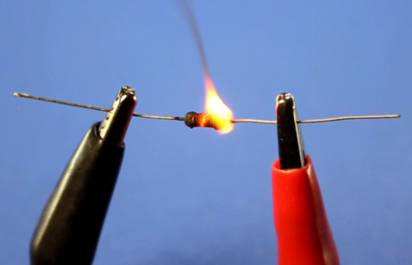
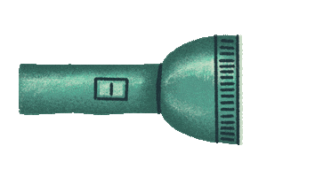
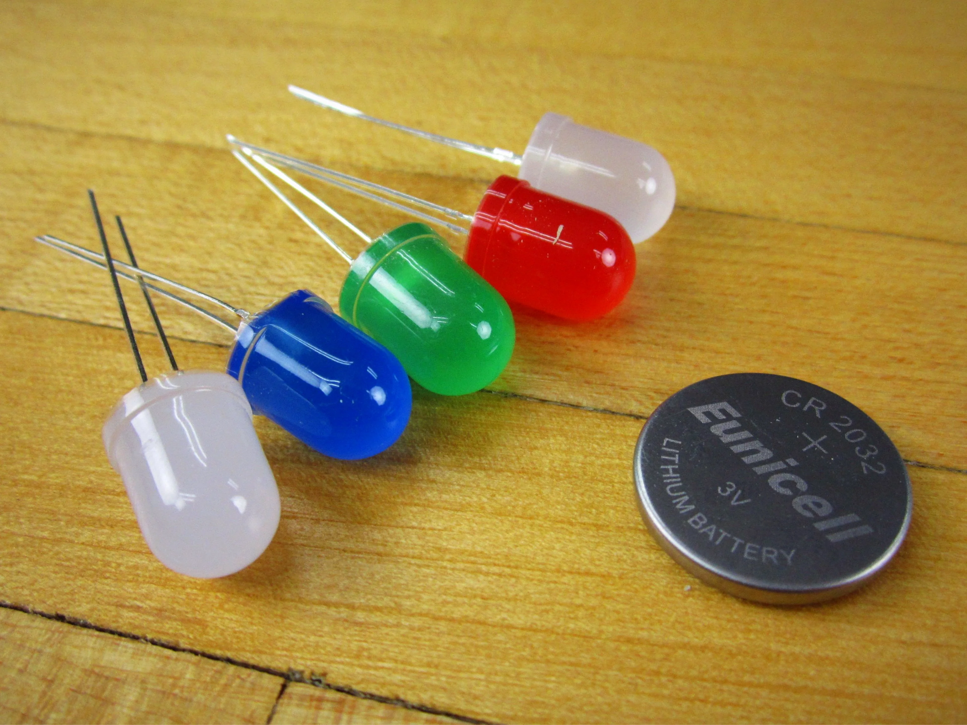
DIY Flashlight Workshop

Slide 2
What Are We Learning Today ?
Basics of electric circuits :
Polarity
Ohm's Law
Voltage and Current
What is a breadboard and how do they work ?

Slide 3
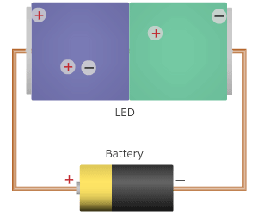
What is an LED ?
Light Emitting Diode
To make an LED, just 2 materials are needed
N-type semiconductor : Holds positive charges
P-type semiconductor : Holds negative charges
Between the two semiconductors is a barrier to stop the charges from crossing.
The barrier becomes less effective as voltage is increased
As the barrier stops working, charges move across the junction and when a positive and negative charge combine, you get light

Slide 4
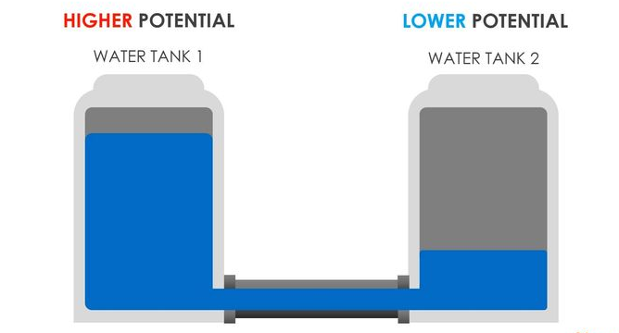
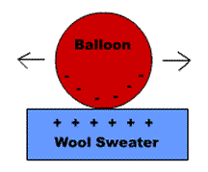
But then what is voltage ?
Voltage is the “measure of the amount of charge at one location, relative to another”
Like charges (charges of the same kind) repel each other
This “push” of the charges trying to repel each other is voltage

Slide 5
What we are building
Our LED’s are rated to turn on at 2 ish Volts and 15 ish mA
We have a 3 Volt battery
But these don’t match !!!
How can we fix this ?

Slide 6
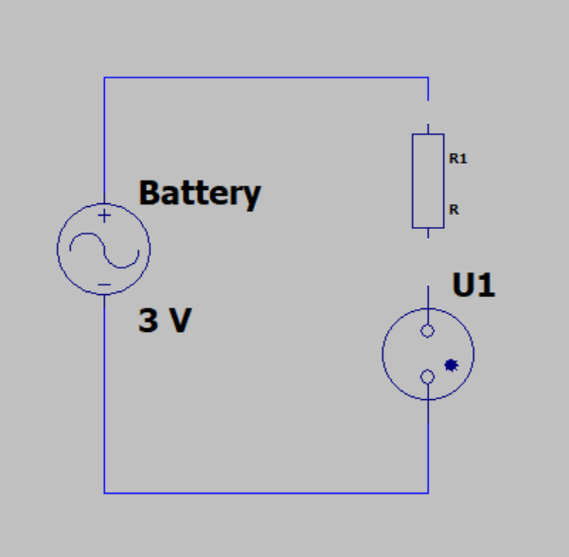
Engineer Our Circuit
? V
3 V
2 V
LED

Slide 7
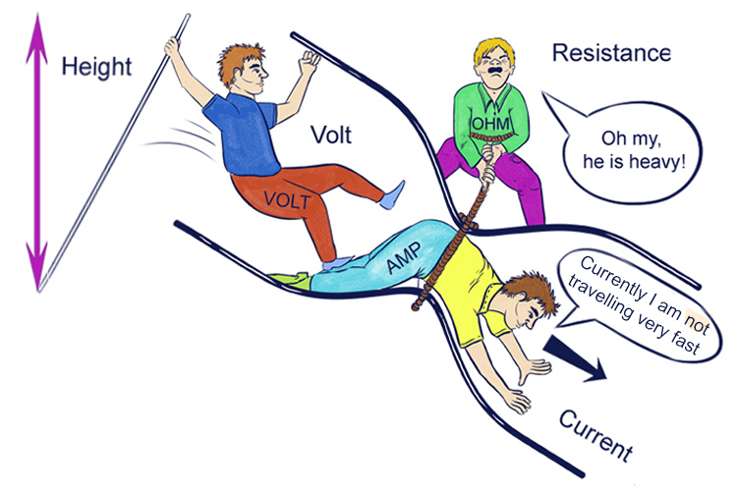
Ohm’s Law
Voltage = Current * Resistance
~ 1 V = ~15mA * R
R = ~70 ohms
Round up to 100 ohms

Slide 8
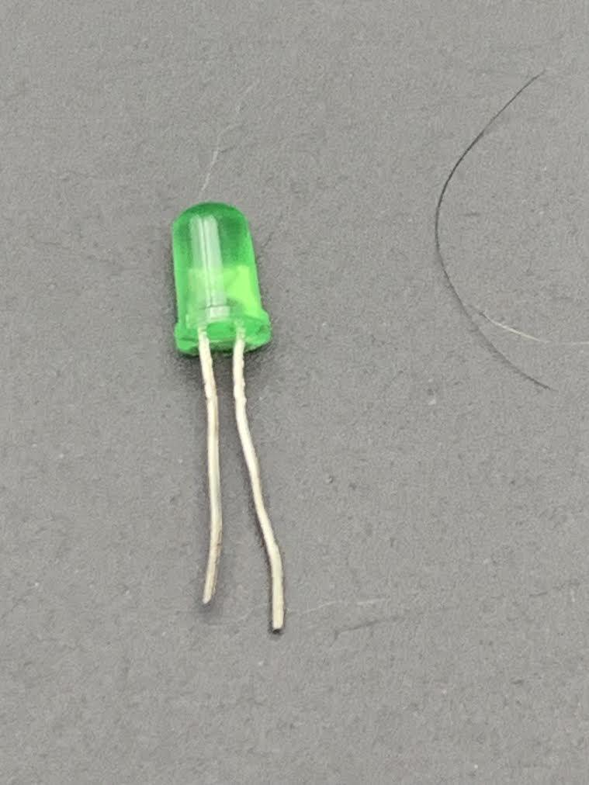
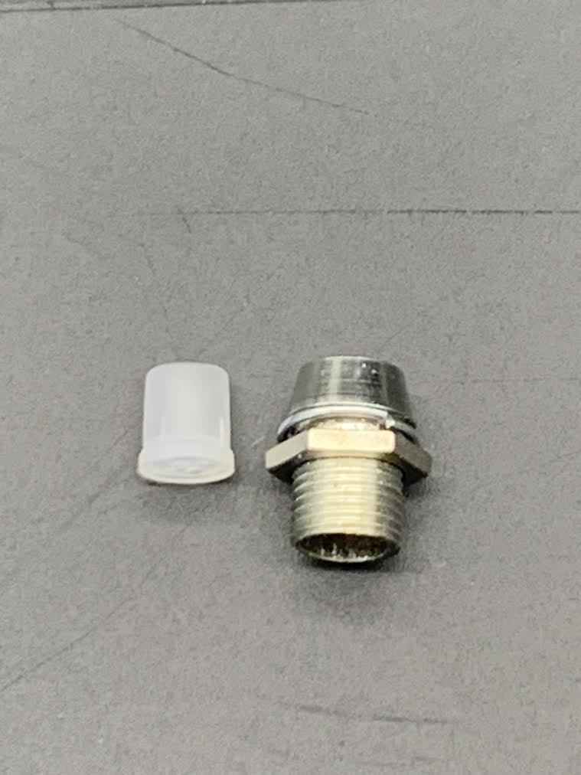
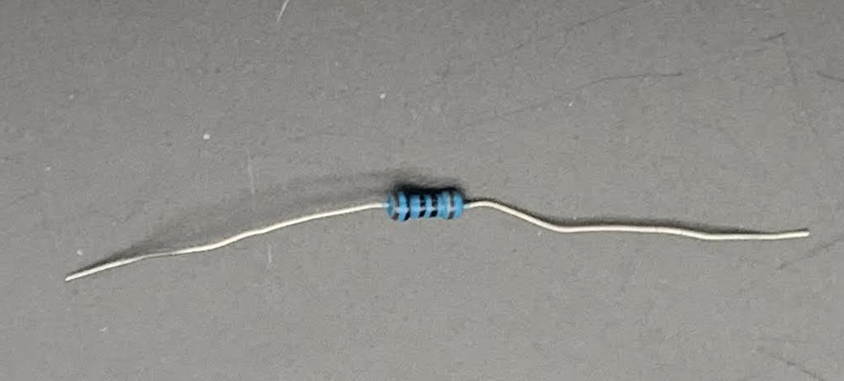
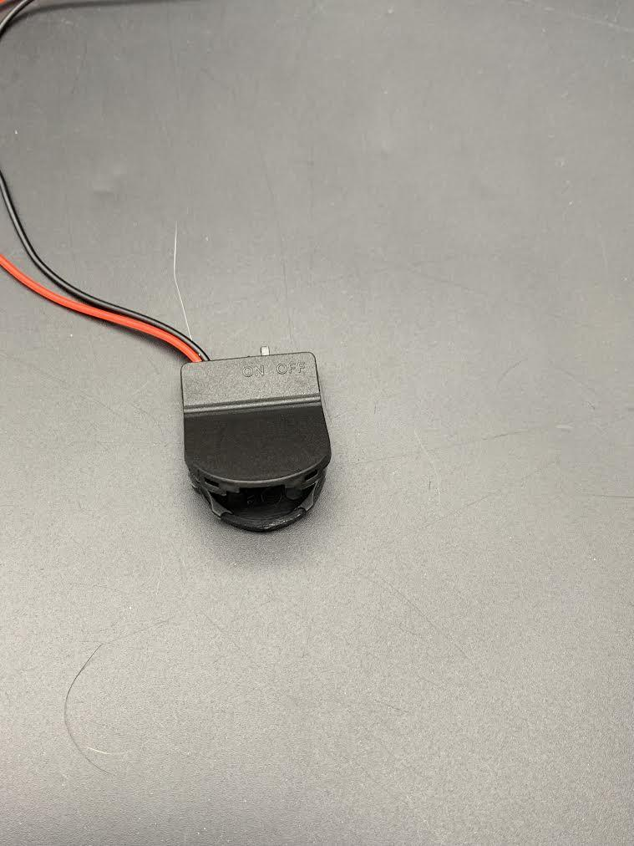
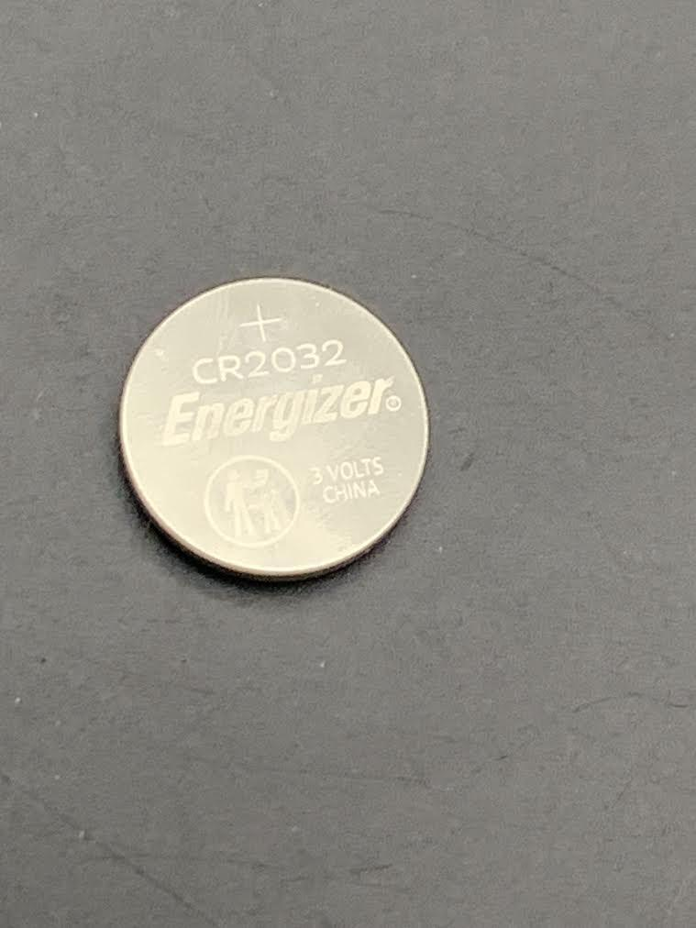
Materials
Parts:
2x Clear 5mm LEDs - Color of your choice.
2x 5mm LED Holder - Chrome
1x 100 Ohm resistors
1x 3 volt CR2032 battery and holder
1x Plastic container

Slide 9
Step by Step!

Slide 10

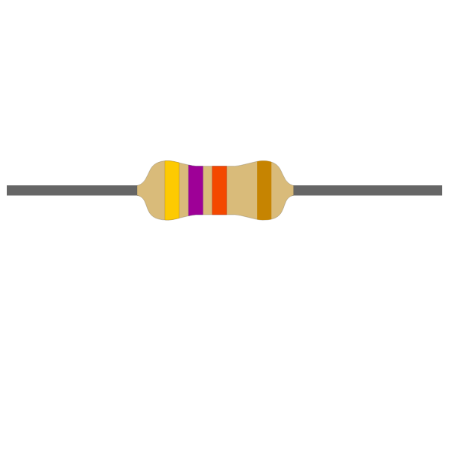
Black Leg = Short (-)
Red Leg = Long (+)

Slide 11
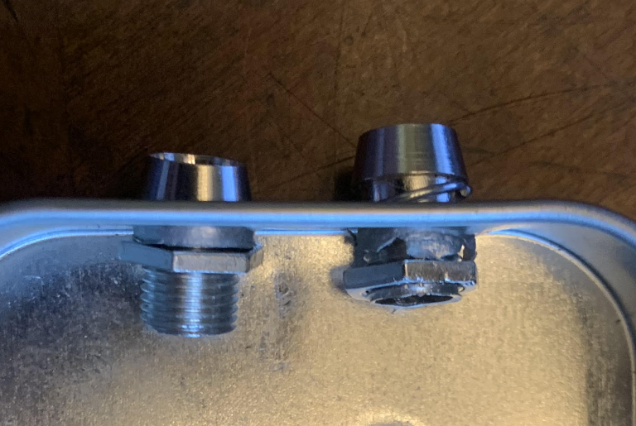
Step 1
Prepare your container:
1. Screw on LED holders

Slide 12
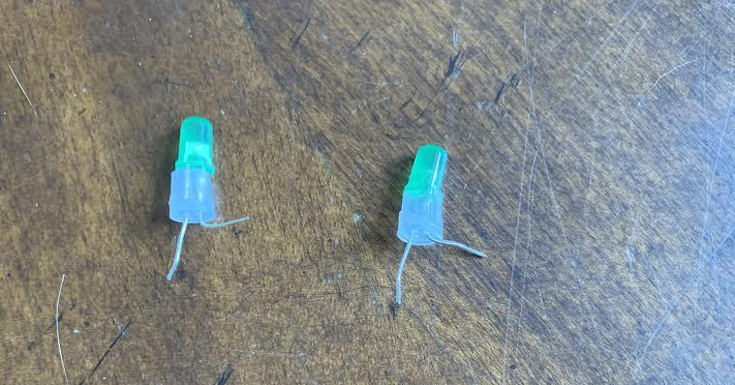
Step 2
Prepare your LED’s carefully:
1. Insert both LED legs through the plastic holder.
2. Pull shorter leg up by 90 degrees (this leg is the negative side of the LED)

Slide 13
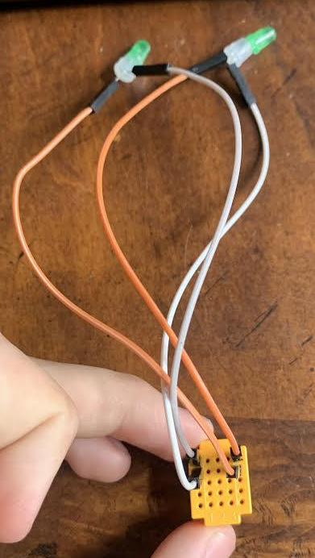
Step 3
Connect LED’s
Connect short leg of LED to left column of board.
Connect long leg to the right column of board.
(this step is crucial as LED’s only works
when electricity is flowing in the right
direction.)
*Please note: Colors of wire shown might not coordinate with your own.

Slide 14
Black Leg = Short (-)
Red Leg = Long (+)
Add in battery and resistor!

Slide 15
Step 4
Assemble into plastic container:

Slide 16
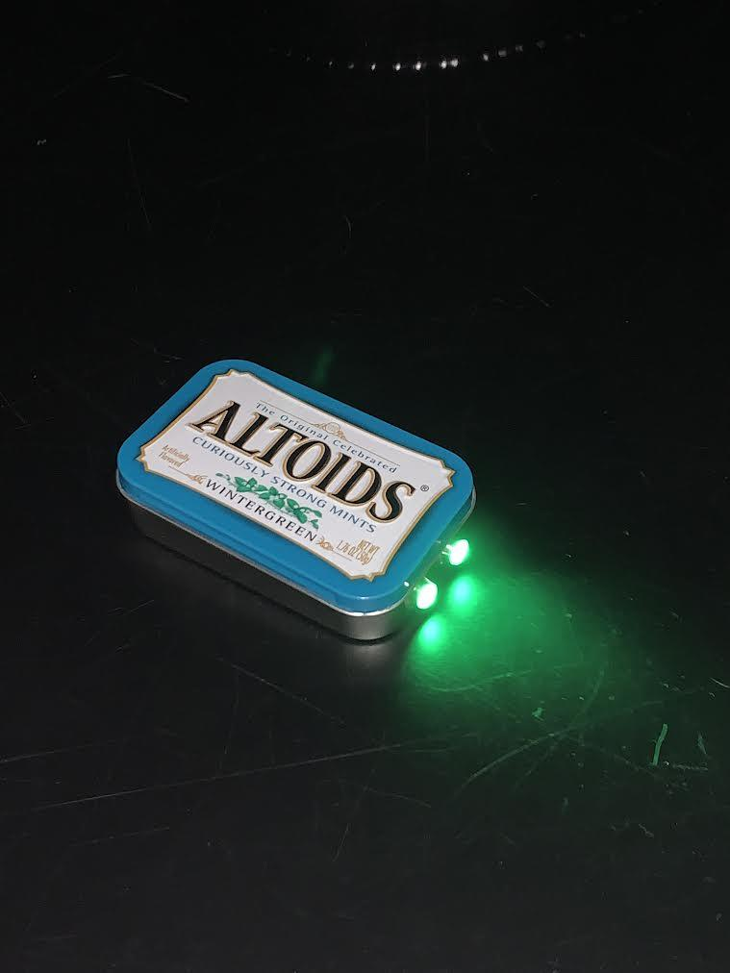
The End!
Congratulations on building your very own flashlight!

